Slide 1
Technical Communication 《技术传播学》
总策划：金晶 凌建辉
第一季教案主创：李黎
资料采集：邢国垣
第二季教案：邢国垣 李黎
技术支持：研究生外语教学部全体教师

Slide 2
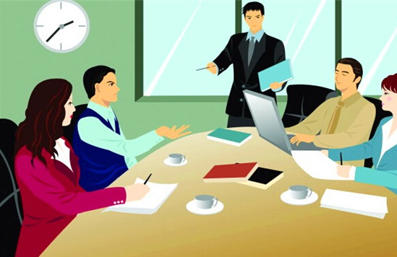
Technical Communication(Episode 1) 《技术传播学》第一讲
An Introduction to Technical Communication（技术传播学绪论）
Drafting emails for work(职场电子邮件)

Slide 3
1. An Introduction to Technical Communication（技术传播学绪论）
1）WHAT particular information and activities are involved in technical communication.
2) HOW we study this program
3) The DOCUMENTS we will learn about drafting

Slide 4
2. Drafting emails for work(职场电子邮件)
1) The format elements of emails for work
2) Tips on drafting emails for work:
a. Professional language style
b. Culture study (email netiquette)
c. Ethical research

Slide 5
1. An Introduction to Technical Communication
1）WHAT particular information and activities are involved in technical communication.

Slide 6
1. An Introduction to Technical Communication
Preview and consideration
The Overview: Unmasking the Mysteries of Technical Communication(总观：解密技术传播学)
Question 1: What are the major concerns of technical communication?

Slide 7

Questoins in our consideration could be
What is technical communication, as a field of study or practice?
What do people do in technical communication?
What’s so special about technical communication? How different is it from other forms of communication?
What kind(s) of people do technical communication? Are there specially trained professionals who do technical communication as a career?
What are the skills and tools involved in the communication?

Slide 8
Suggested clues for question 1:
What is technical communication?
Two ways of observing TC:
The process of making and sharing information and ideas in the workplace.
A set of applications—the documents you write.

Slide 9
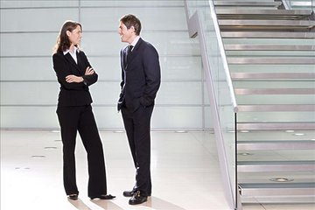
Examples of technical communication
The conversations with your colleagues in the hallway.

Slide 10
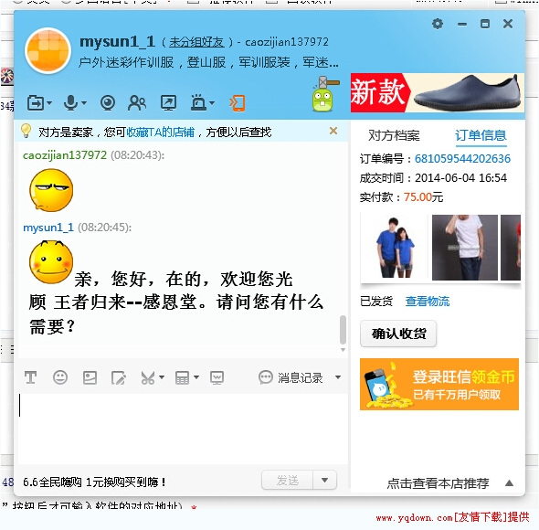
Examples of technical communication
…The text messages you exchange with vendors (like on taobao.com or tmall.com).

Slide 11

Examples of technical communication
The phone calls with your project team…

Slide 12

Suggested clues for question 1:
All professionals use the four communication skills (reading, writing, speaking and listening) to create, design and transmit technical information safely, effectively and efficiently.

Slide 13
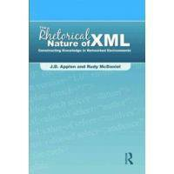


Suggested clues for question 1:
Much of what we read every day in work and life – textbooks, computer-based training videos, procedures manuals, Websites, owner’s manuals – is technical communication.

Slide 14
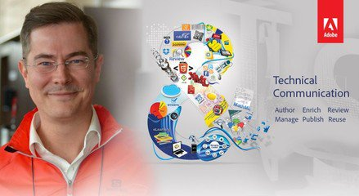
Suggested clues for question 1:
There are specialized professionals working in companies who are called technical communicators. The career is routinely among the top ones on the job hunting list of industries.

Slide 15
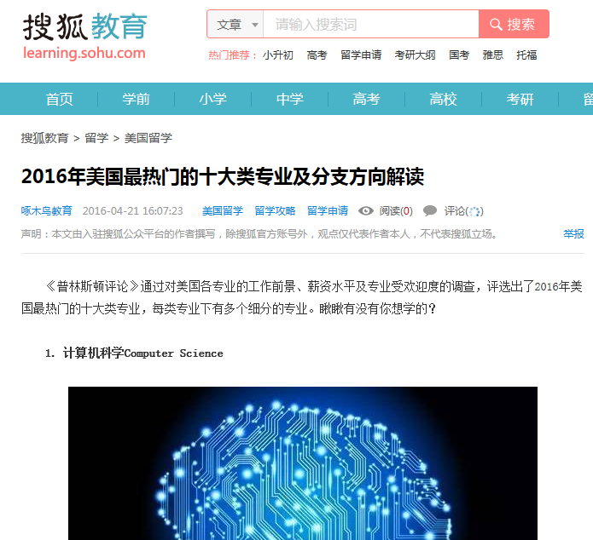

Slide 16
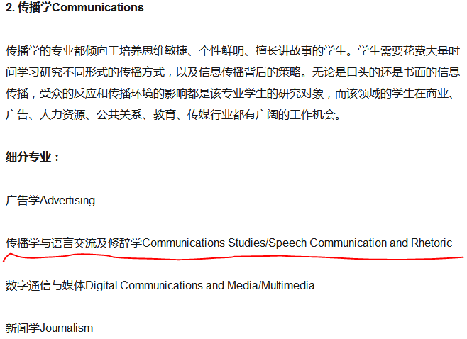

Slide 17
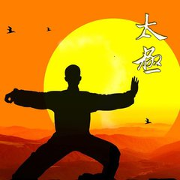


Question 2: Why do we have to study technical communication as a course or a program in college?
Suggested context: suppose you are a public-health scientist working for the CDC (Center of Disease Control). You have recently completed a study showing that, for adults, moderate exercise provides as much health benefit as strenuous exercise.
Question for discussion:
How would you report the results of the study in a journal article, in a press release to popular print and online publications, or in a blog and podcast(播客) on the CDC Web site in different ways to various audiences?

Slide 18

Coming up will be the clues for reference …

Slide 19
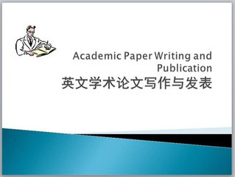
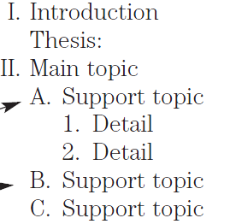
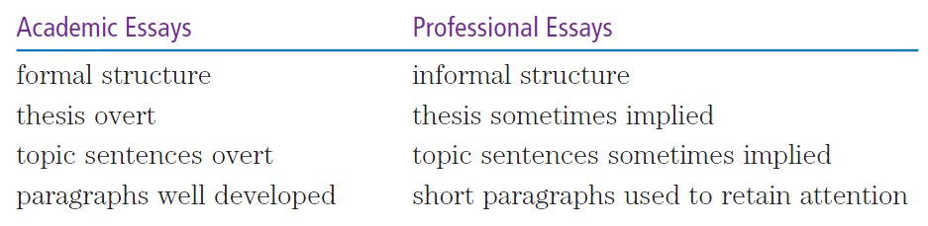
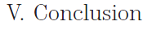
When you publish your article on a journal, you have to abide by the rules of academic writing.

Slide 20
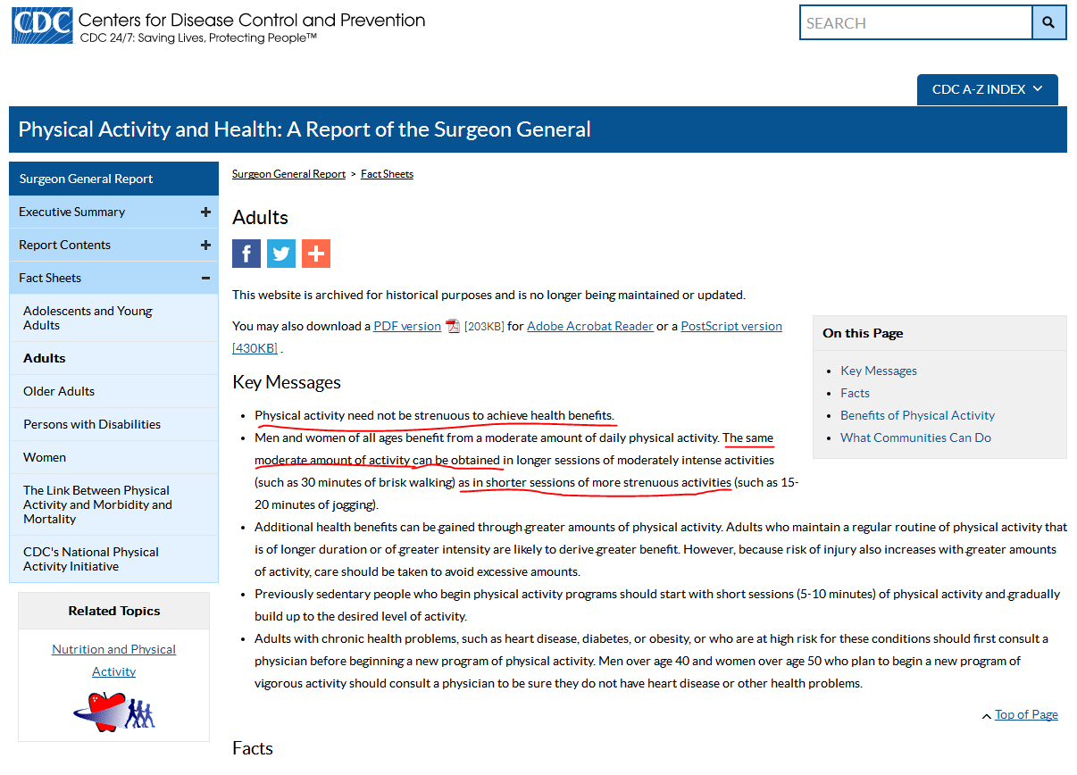

Online publication has greater:
access (multiple terminals)
interaction (feedback functions)
convenience for citation
… legal and ethical concerns

Slide 21
Suggested clues for question 2
Compared to other kinds of communication, especially in writing, technical communication has a considerably different focus on audience and purpose.

Slide 22
The audience
In technical communication your audience will likely include professional peers and supervisors as well as partners and customers in your business. While taking actions, you have to observe particular business regulations and company policies for working circumstances.

Slide 23
The Purpose
Your purpose in technical communication will likely be to reinforce or change their attitude toward the subject you are writing about, motivate them to take particular actions, or help them carry out their own work-related tasks.

Slide 24
2) HOW we study this program

Slide 25
The Perspectives: Venturing into the practices and theories in TC (分论: 透析技术传播之“技”与“术”)
This is about how we will carry out our study in this program of TC, which may be different from the way such similar courses were conducted as “business communication” , “practical writing”, etc.

Slide 26
3 letters represents the procedure of each time’s class study:
P：Professional cases
C: Culture study
E: Ethical Research

Slide 27
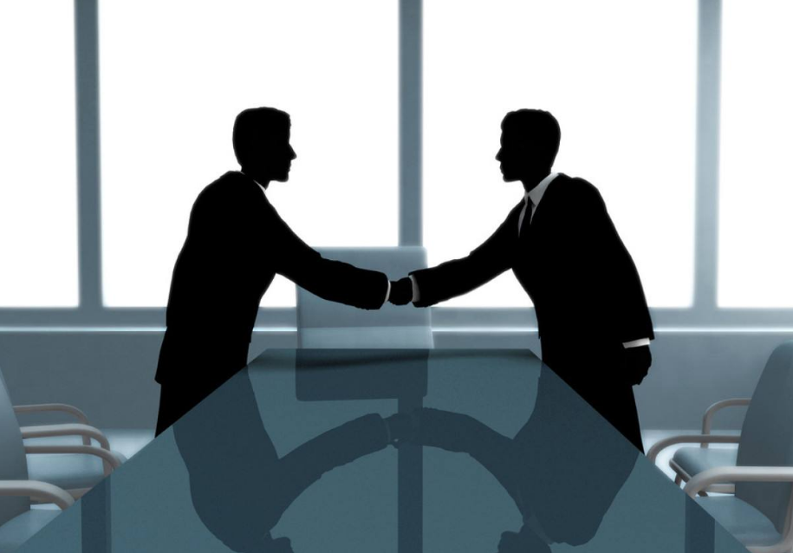

Our program will be about
Professional skills.
Cases from practical situations will be studied. We will learn about the drafting format, language tactics, typical flaws, efficiency expertise.

Slide 28
Also we will have the Culture study in TC: shocks and strategies for effective communications:
Some Chinese and foreign ladies and gentlemen will be with us in the cases for study.

Slide 29

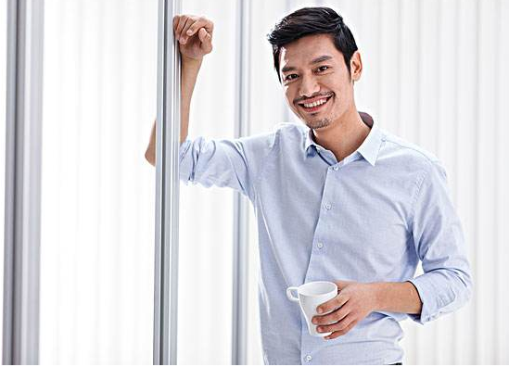
黄晓明
Huang Xiaoming
is a technical professional working for Gultra Electronics, a US microchip manufacturer stationed in Jiu Long Hu Campus, Southeast University. Experienced in IT operation, he still needs training in technical communication.

Slide 30

杨颖
Yang Ying works for Gultra Electronics in the marketing department. She graduated from the English Department of SEU and got her master’s degree in technical communication from the University of Minnesota.

Slide 31
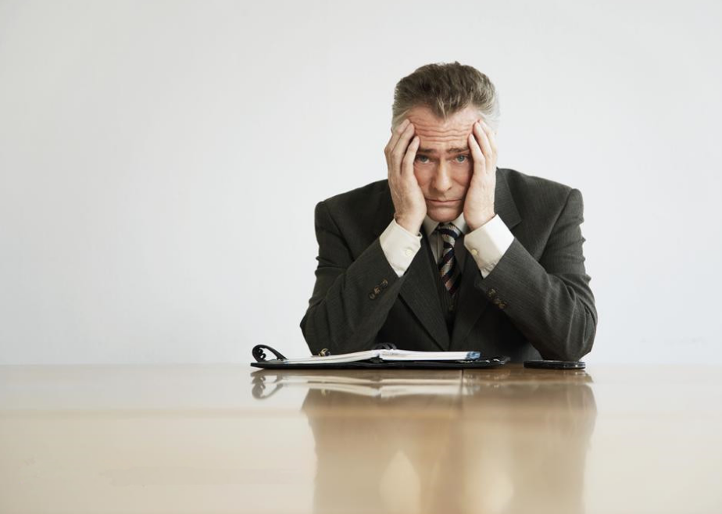
Sam
Sam is the factory manager of Gultra Electronics. He has been working in China for over 10 years.

Slide 32
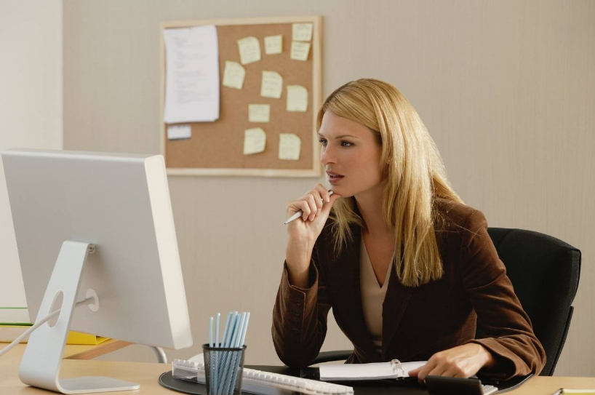
Jane
Jane is the project manager in Gultra Electronics. She was just promoted and appointed to Nanjing three months ago.

Slide 33

Moreover, for each case we will do some research on Ethics in technical communication: integrating efficiency and morality in TC

Slide 34
小组活动指南 (tips for role-play and cooperation in group work )
Speak actively. Do not just repeat or paraphrase. Provide as much information as possible.
Discuss in order. While others are speaking, do not interrupt until they finish the talk.
Think critically. Try to find proper reasons for any view you hold and express them.
Learn creatively. Each time you play a role, experiment with the cultural identity and related behavioral manner.

Slide 35
3) The DOCUMENTS we will learn about drafting
Unit 1: Emails for work
Unit 2: Memos
Unit 3: Résumés for job application
Unit 4: Instructions and user manuals

Slide 36

Drafting emails for work (Professional Case)
1) The format elements of emails for work
Task 1: In groups, brainstorm and make a list of the elements of an email from your own experience.

Slide 37
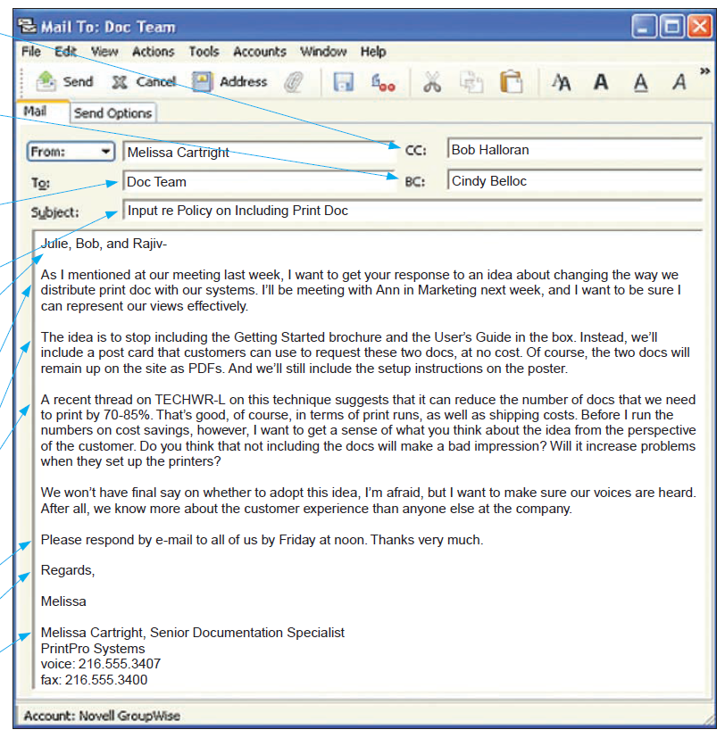
Sample for reference

Slide 38
Sample for reference

Slide 39
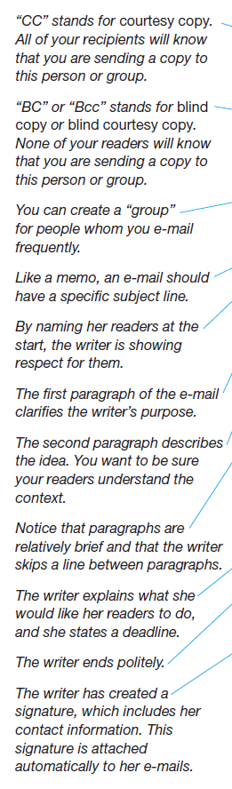
Sample for reference

Slide 40
2) Tips on drafting emails for work

Slide 41

Task 2: Yang Ying and Huang Xiaoming began dating weeks ago and have been exchanging emails frequently. What tips would you suggest to them for their emails to Jane and Sam, their business partners? In what ways are these emails different? (suggestion: consider language, culture, and ethics, etc.)

Slide 42


Task 3: Comment on the following email Huang Xiaoming wrote to Sam. Suppose how Yang Ying would help him revise the email.
To: Supers and Leads
Subject:
LATELY, WE HAVE BEEN MISSING LASER REPAIR FILES FOR OUR 16MEG WAFERS.
AFTER BRIEF INVESTIGATION, I HAVE FOUND THE MAIN REASON FOR THE MISSING
DATA.
OCCASIONALLY, SOME OF YOU HAVE WRONGLY PROBED THE WAFERS UNDER THE
CORRELATE STEP AND THE DATA IS THEN COPIED INTO THE NONPROD STEP USING
THE QTR PROGRAM. THIS IS REALLY STUPID. WHEN DATE IS COPIED THIS WAY THE
REPAIR DATA IS NOT COPIED. IT REMAINS UNDER THE CORRELATE STEP.
TO AVOID THIS PROBLEM, FIRST PROBE THE WAFERS THE RIGHT WAY. IF A
WAFER MUST BE PROBED UNDER A DIFFERENT STEP, THE WAFER IN THE CHANGE FILE
MUST BE RENAMED TO THE ** FORMAT.
EDITING THE WAFER DATA FILE SHOULD BE USED ONLY AS A LAST RESORT, IF THIS
BECOMES A COMMON PROBLEM, WE COULD HAVE MORE PROBLEMS WITH
INVALID DATA THAT THERE ARE NOW.
SUPERS AND LEADS: PLEASE PASS THIS INFORMATION ALONG TO THOSE WHO NEED
TO KNOW.
Huang Xiaoming

Slide 43
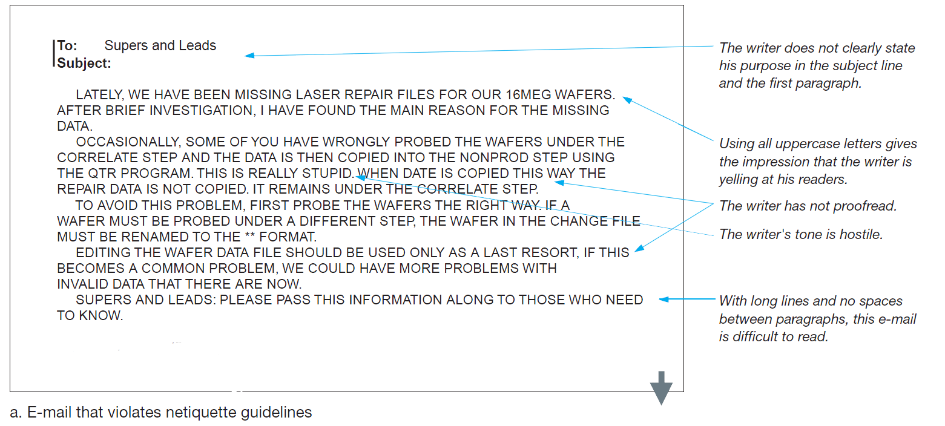
Yang Ying has pointed out the netiquette issues in the email.

Slide 44
And she has more suggestions on Netiquette. (Culture study, ethical research and language use are all part of professional skills for drafting emails)
Before you write an e-mail in the workplace, find out your organization’s e-mail policies. Most companies have written policies that discuss circumstances under which you may and may not use e-mail, principles you should use in writing e-mails, and the monitoring of employee e-mail.

Slide 45

Netiquette guidelines for writing a business email
Netiquette refers to etiquette on a network.
Stick to business
Use appropriate formality
Write correctly
Don’t flame
Make your message easy on the eyes
Don’t forward a message to an online discussion forum without the writer’s permission
Don’t send a message unless you have something to say

Slide 46

Use the appropriate level of formality
Context: Huang Xiaoming tends to be confused about the level of formality in drafting emails. Play Sam’s role here and help Xiaoming better revise the following sentences.

Slide 47
Use the appropriate level of formality
Our meeting with United went south right away when they threw a hissy fit, saying that we blew off the deadline for the progress report.
Comment: too informal.
Revision: In our meeting, the United representative expressed concern that we had missed the deadline for the progress report. (MODERATELY FORMAL)

Slide 48
Use the appropriate level of formality
It was indubitably the case that our team was successful in presenting a proposal that was characterized by quality of the highest order. My appreciation for your industriousness is herewith extended.
Comment: too formal.
Revision: I think we put together an excellent proposal. Thank you very much for your hard work. (MODERATELY FORMAL)

Slide 49
Tips on appropriate level of formality
People are sometimes tempted to use informal writing in informal digital applications such as e-mail and microblogs.
Don’t do this while drafting emails for WORK.
Remember that everything you write on the job is legally the property of the organization for which you work, and messages are almost always archived digitally, even after recipients have deleted them.
Remember, too, that they might be read by the company president, or they might appear in a newspaper or in a court of law. Therefore, use a moderately formal tone to avoid potential embarrassment.

Slide 50

A Brief Introduction to Ethics in Technical Communication
Ethicist Manuel G. Velasquez outlines four moral standards that are useful in thinking about ethical dilemmas (2006):
Rights （权利）
Justice （公正）
Utility （用途）
Care （关怀）
Discussion: Sam and Jane often argue about the 4 standards. Sam observes that some interests have to be sacrificed for greater welfare while Jane argues that welfare involves all human interests. Play their roles in pairs and try the argument with regard to the practice of technical communication such as in drafting the emails, memos, résumés, user manuals, etc.

Slide 51

1) Rights.
This standard concerns individuals’ basic needs and welfare. Everyone agrees, for example, that people are entitled to appropriate safety warnings with new products in the instruction.

Slide 52

2)Justice.
This standard concerns how the costs and benefits of an action or a policy are distributed among a group. For example, racism or gender biases are sensitively issues to be resolved in technical communication.

Slide 53
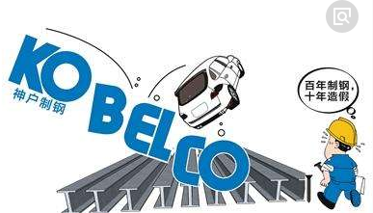
3) Utility.
This standard concerns the positive and negative effects that an action or a policy has, will have, or might have on others. For example, Japanese Steelmaker Kobe keeps making profits by forging safety information but the misconduct affected over 500 companies.

Slide 54
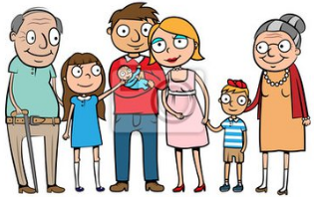
4) Care.
This standard concerns the relationships we have with other individuals. We owe care and consideration to all people, especially to those closer to us, such as our family.

Slide 55
Questions for review:
Did you refrain from discussing nonbusiness subjects?
Did you keep the e-mail as brief as possible and send it only to appropriate people?
Did you use appropriate formality?
Did you write correctly?
Did you avoid flaming?
Did you write a specific, accurate subject line?
Did you use uppercase and lowercase letters?
Did you skip lines between paragraphs?
Did you keep the line length under 65 characters?
Did you check with the writer before forwarding his or her message?

Slide 56
Homework
Revise an email in the following context:
Sam is chairing a committee to investigate ways to improve the hiring process at the company. Huang Xiaoming also serves on the committee. The following excerpts quoted in Sam’s e-mail are from an e-mail written by Huang Xiaoming to all members of the committee in response to Sam’s request that members describe their approach to evaluating job-application materials. How would you revise Sam’s e-mail to make it more effective?

Slide 57
To: Huang Xiaoming
From: Sam
Sometimes I just have to wonder what you’re thinking,
Xiaoming.
>Of course, it’s not possible to expect perfect
>resumes. But I have to screen them, and
>last year I had to read over 200. I’m not looking for
>perfection, but as soon as I spot an error I make
>a mental note of it and, when I hit a second and
>then a third error I can’t really concentrate on the
>writer’s credentials.
Listen, Xiaoming, you might be a sharp editor, but the
rest of us have a different responsibility: to make the
products and move them out as soon as possible.
We don’t have the luxury of studying documents to
see if we can find errors. I suggest you concentrate
on what you were hired to do, without imposing
your “standards” on the rest of us.
>From my point of view, an error can include a
>misused tradmark.
Misusing a “tradmark,” Xiaoming? Is that Error Number 1?

Slide 58

Thanks for your attention!

